Slide 1
Comparative analysis of Industry sectors
Determining which sectors have more stability and growth prospects

Slide 2
Overview
Overview of sectors
Comparative analysis
Charts and graphs
Conclusions

Slide 3
Overview of Sectors
Sectors include:
Consumer discretionary
Consumer staples
Energy
Financials
HealthCare
Industrials
Information Technology
Materials
Real Estate
Telecommunication services
Utility

Slide 4
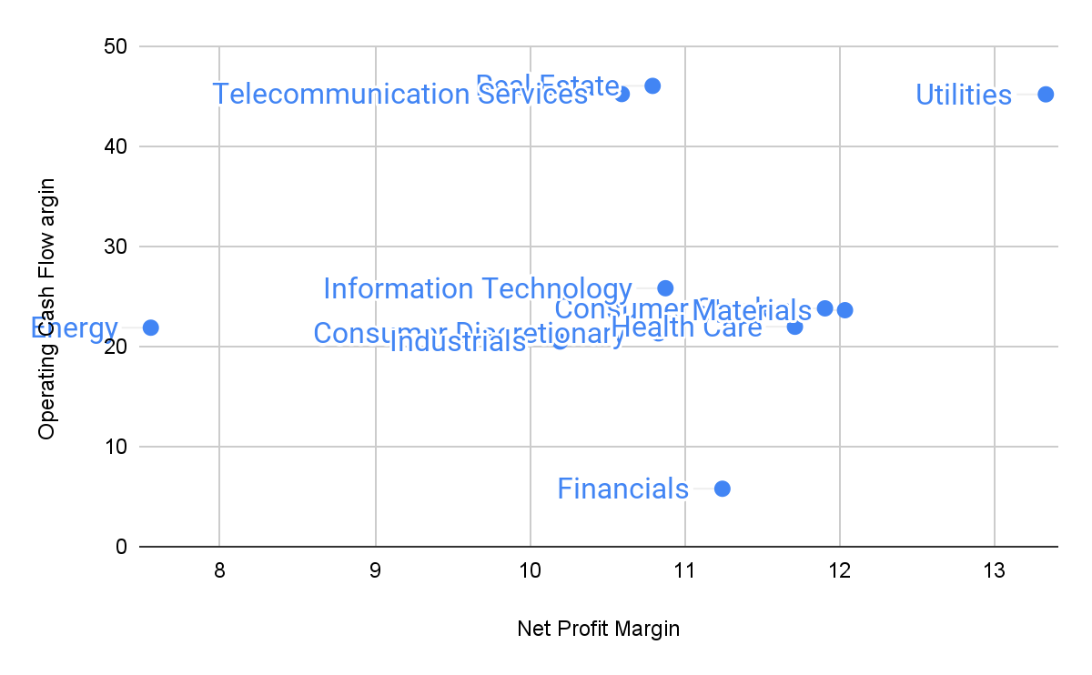
Low Npm, High Opcfm
High Npm, High Opcfm
The data shows the real estate, telecommunication and utilities sectors have both high net profit and operating cash flow margin. This implies Majority of their revenue remains as profit and these sectors are efficient at generating cash from its operations showing they can efficiently manage debt, weather economic downturns and produce superior returns for its shareholders thereby indicating better stability and growth prospects

Slide 5
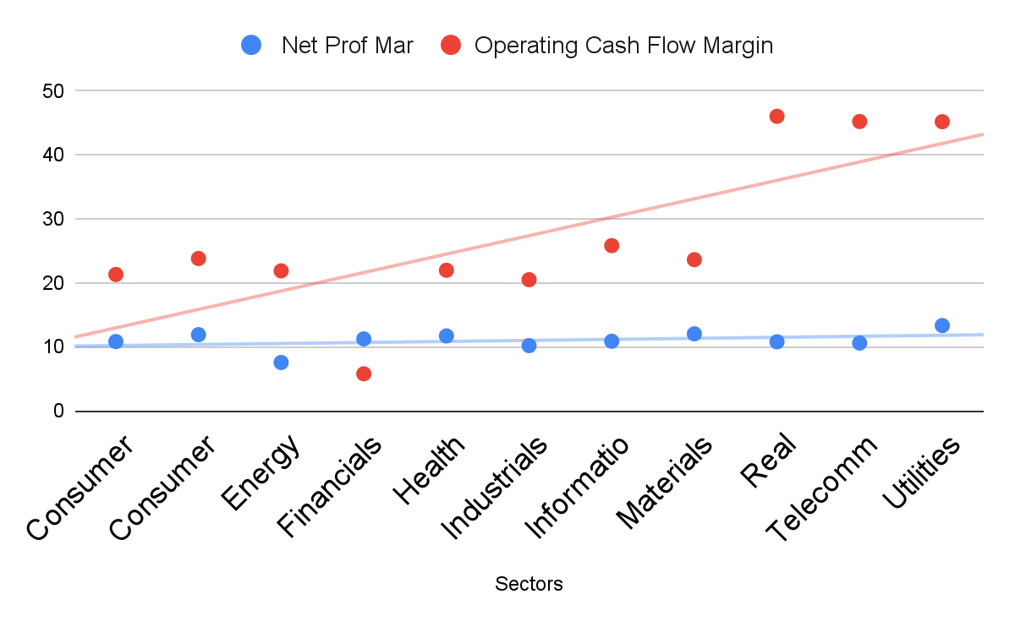
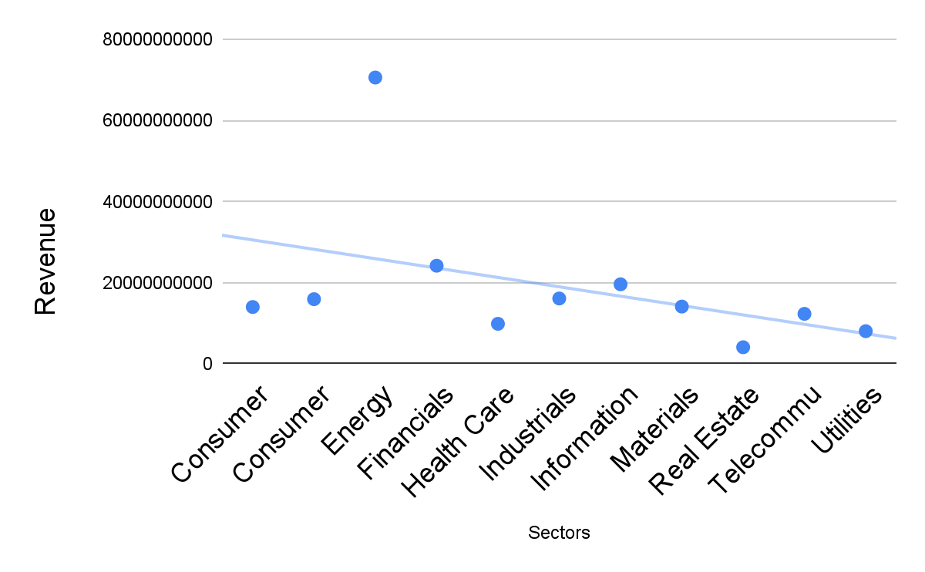
The rest of the sectors in comparison with those three sectors have a smaller operating cash flow margin(as shown in first figure) and even though their net profit and revenue(shown in second figure) are about the same or even greater than those three, a smaller operating cash flow implies most of their ‘profits’ is not actual cash from it’s operations and may face challenges in maintaining consistent cash flows from its core operations

Slide 6
Conclusion
As we wrap up the presentation, we can identify that, The real estate, utility and Telecommunication Sector presents compelling investment opportunities compared to the other sectors because of its ability to generate profit from it’s revenue and it’s ability to generate cash from its core operations

Slide 7
THANK YOU

